Slide 1
HBM4EU project
Establishing HBM Guidance Values (HBM-GV)
Specificities of deriving HBM-GV for the occupational field
&
Case study: HBM-GV_{worker} for Cadmium
Eva OUGIER (ANSES)
3rd HBM4EU Training School
- 20th June 2019 -

Slide 2
Biological monitoring (biomonitoring) in occupational safety & health
Detection of substances (biomarkers) in biological samples of workers to assess exposure & health risks, by comparing the measured values with appropriate references
 Fundamental for assessing and monitoring individual & collective chemical risks
Allows for:
Identifying risky occupational activities
Measuring the contamination of individuals (workers)
Guiding exposure reduction measures
Assessing the effectiveness of the exposure reduction measures
Ensure that the exposure of workers does not entail an unacceptable health risk - essentially a preventive activity
3rd HBM4EU Training School - Brno - 20th of June 2019
Notes:
Early detection of hazardous exposures may significantly decrease the occurrence of adverse health effects by reducing the level of exposure thanks to appropriate preventive measures. Monitoring of exposure is a procedure which consists of the routine assessment and the interpretation of biological and/or ambient parameters in order to detect possible health risks. This approach requires (a) the definition of permissible levels of exposure, that is, levels that according to the present status of knowledge are estimated to cause no adverse effects during the lifetime of the workers; and (b) the regular assessment of the possible health risks associated with exposure by comparing the current or integrated exposure with these permissible exposure limits

Slide 3
Some specificities of the derivation of HBM-GV_{worker}
1) To derive the HBM-GV_{worker}, preference is given to:
* Field studies containing data on dose-response effects or biological effects (HBM data  health effects)
* Human volunteers/Cohort studies containing data on dose-response effects or biological effects (HBM data  health effects)
* Based on exposure limit levels (e.g. OEL) provided correlations between air levels and selected biomarker(s) level have been established
Deriving the HBM-GV_{worker} from animal toxicological studies (external doses) involves many extrapolations/assumptions  Recommendation to the occupational hygienists to better rely on the biological reference value to assess exposure of workers at the workplace
3rd HBM4EU Training School - Brno - 20th of June 2019
Notes:
Early detection of hazardous exposures may significantly decrease the occurrence of adverse health effects by reducing the level of exposure thanks to appropriate preventive measures. Monitoring of exposure is a procedure which consists of the routine assessment and the interpretation of biological and/or ambient parameters in order to detect possible health risks. This approach requires (a) the definition of permissible levels of exposure, that is, levels that according to the present status of knowledge are estimated to cause no adverse effects during the lifetime of the workers; and (b) the regular assessment of the possible health risks associated with exposure by comparing the current or integrated exposure with these permissible exposure limits

Slide 4
Some specificities of the derivation of HBM-GV_{worker}
Interindividual (human) variability assessment factor (AF_{H})
 accounting for general physiological and metabolic variation within the human population and the possibility that there may be sensitive subpopulations due to variations in e.g. age, sex, genetic susceptibility, pre-existing diseases
AF_{H} default value of 10 for the general population (including toddlers, child, elderly …)
AF_{H} default value of 5 for the workers, as considered a more homogeneous (do not include very young and very old individuals) and healthier population (healthy worker effect)
Consideration of the most probable route of exposure for workers (dermal/inhalation)
Special attention given to the recommended moment of sampling, depending on the substance half-life (pre- or post-shift, beginning or end of the working week, …)
3rd HBM4EU Training School - Brno - 20th of June 2019
Notes:
Early detection of hazardous exposures may significantly decrease the occurrence of adverse health effects by reducing the level of exposure thanks to appropriate preventive measures. Monitoring of exposure is a procedure which consists of the routine assessment and the interpretation of biological and/or ambient parameters in order to detect possible health risks. This approach requires (a) the definition of permissible levels of exposure, that is, levels that according to the present status of knowledge are estimated to cause no adverse effects during the lifetime of the workers; and (b) the regular assessment of the possible health risks associated with exposure by comparing the current or integrated exposure with these permissible exposure limits

Slide 5
Reminder: options for deriving HBM-GVs
Case study 2
Deriving HBM-GVs_{worker} with regard to Cadmium (Cd)
From human data, based on a relationship between measured HBM concentrations and health effects
Option 1
NO
On the basis of external limit values proposed by EU or relevant non-EU bodies
Option 2
NO
On the basis of critical effects observed in animal toxicological studies
Option 3
3rd HBM4EU Training School - Brno - 20th of June 2019

Slide 6
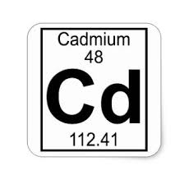
Case study 2
Derivation of a HBM-GV_{worker} with regard to Cadmium (Cd)
Heavy metal found as environmental contaminant through natural occurrence and from industrial & agricultural sources (fertilizers)
1 - Uses of Cd and its compounds
for plating of steel and iron (rust-protecting coating)
as plastic stabilizer
as pigments (e.g. engineering plastics, glass, ceramics, rubber, enamels artists’ colours and fireworks)
in electrode material in Ni-Cd batteries
in low-melting alloys (solar panels)
3rd HBM4EU Training School - Brno - 20th of June 2019
Notes:
The main Cd compounds found in the industry

Slide 7
2 - Workers exposure to Cd
Worker’s exposure to Cd and inorganic Cd compounds: wide variety of occupations
Occupations with highest potential levels of exposure:
- smelting zinc and lead ores
- welding or remelting cadmium-coated steel
- working with solders that contain Cd
- producing, processing, and handling Cd powders
(- also: recycling of scrap metal and Ni-Cd batteries)
Mining, smelting and industrial usage of Cd  considerable exposure, now fairly well controlled in long-established industrialized countries (but still problems in developing countries and in some newly industrialized countries)ª
Processes that involve extremely high temperatures (e.g. iron & steel industries  volatilization and emission as vapour^{b}
ª IUPAC, 2018
^{b} EFSA, 2009
3rd HBM4EU Training School - Brno - 20th of June 2019
Notes:
The main Cd compounds found in the industry

Slide 8
3 - Toxicokinetic
Inhalation is the primary route of exposure to cadmium (dust, smoke) for workers
Absorption : pulmonary preferentially
Fraction absorbed depends on physico-chemical properties
Dermal : negligible
Distribution : kidney and liver preferentially
Binding with methallothionein, albumin and erythrocytes
Bioaccumulation : kidney and liver (half-life of 10 to 30 years)
Metabolism : no transformation
Excretion : urinary (most largely)
3rd HBM4EU Training School - Brno - 20th of June 2019
Notes:
The main Cd compounds found in the industry

Slide 9
4 - Classification and EU legislation
IARC Group 1- Carcinogenic to humans (Cd & Cd compounds cause cancer of the lung; inconsistent (limited) evidence that Cd & Cd compounds exposure increases risks of kidney or prostate cancer)
Harmonised CLP classification of Cd and Cd compounds
Cd metal | Cd dichloride | Cd oxide | Cd sulfate | Cd sulfide | Cd nitrate | Cd hydroxide
Carc.1B (H350) Mut.2 (H341) Repr.2 (H361fd) | Carc.1B (H350) Mut.1B (H340) Repr.1B (H360 fd) | Carc.1B (H350) Mut.2 (H341) Repr.2 (H361fd) | Carc.1B (H350) Mut.1B (H340) Repr.1B (H360 fd) | Carc.1B (H350) Mut.2 (H341) Repr.2 (H361fd) | Carc.1B (H350) Mut.1B (H340) | Carc.1B (H350) Mut.1B (H340)
Cd and some Cd compounds identified as Substances of Very High Concern  REACH Candidate list for authorisationª
In 2018: provisional agreement reached between EU Parliament and Council to place limits on Cd in fertilizers at 60 mg Cd/kg limit (application 3 years after entry into force of the new rules – most likely in 2022)
ª https://echa.europa.eu/fr/candidate-list-table
3rd HBM4EU Training School - Brno - 20th of June 2019
Notes:
The main Cd compounds found in the industry

Slide 10
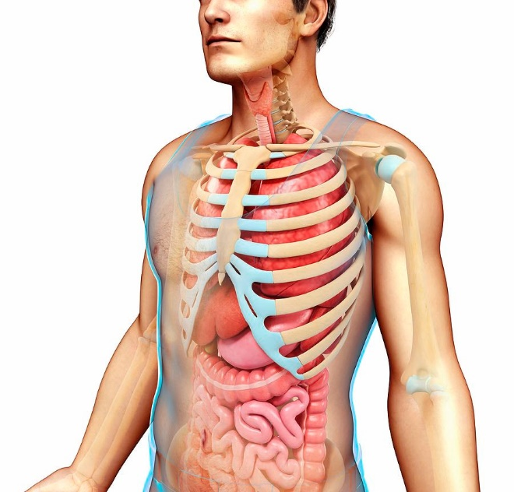
5 - Toxicity
Review of epidemiological and toxicological studies
Respiratory tract
Emphysema, chronic inflammation of nose, pharynx, larynx, chronic obstructive lung disease
Cardiovascular disease
Kidney impairment
Renal tubular dysfunction
Glomerular effects
Renal failure
Bone effects
Osteomalacia, osteoporosis, fracture
Also:
Carcinogenic effects
Developmental neurotoxicity
…
Good dose-response data from epidemiological studies available for kidney effects (and to some extent for bone effects)
Occupationnal studies provide consistent evidence that Cd targets the kidney after chronic exposure
3rd HBM4EU Training School - Brno - 20th of June 2019
Notes:
The main Cd compounds found in the industry

Slide 11
6 - Selection of biomarkers (BMs)
Continuum of exposure – effect for cadmium
Air cadmium
Exposure biomarkers
Effects biomarkers
Renal failure
Biologically effective dose
Altered structure/ function
Exposure
Internal dose
Early biologic effects
Disease
Blood cadmium
Urinary cadmium
GFR decrease
Early BM for tubulopathy increase
Biomarkers of exposure
- Urinary Cd (Long term exposure)
- Blood Cd (Recent exposure)
Biomarkers of effect
Tubular toxicity: early effect biomarkers
Retinol binding protein (RBP)
Beta-2-microglobulin (β2M)
3rd HBM4EU Training School - Brno - 20th of June 2019
Notes:
The main Cd compounds found in the industry

Slide 12
7a - Study of the relationship between the selected effect BMs concentrations & the critical effect
Urinary β2M or RBP (µg.g⁻¹ creat) | Clinical interpretation
< 300 | Normal value
300-1000 | Incipient Cd-induced tubular dysfunction (possibility of reversibility if exposure to Cd not too high)
1000-10000 | Irreversible tubular proteinuria likely to accelerate the decline of glomerular filtration rate (GFR) with age
Bernard, 2004
Air cadmium
Exposure biomarkers
Effects biomarkers
Renal failure
Internal dose
Biologically effective dose
Early biologic effects
Altered structure/ function
Exposure
Disease
Blood cadmium
Urinary cadmium
GFR decrease
Early BM for tubulopathy increase
3rd HBM4EU Training School - Brno - 20th of June 2019
Notes:
The main Cd compounds found in the industry

Slide 13
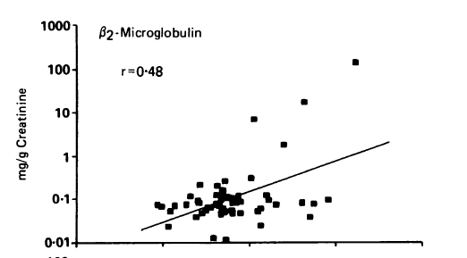
7b - Study of the relationship between exposure BMs & effect BMs concentrations
Review of field studies reporting simultaneous measurement of exposure biomarkers (Blood or Urinary Cd) and early effect biomarkers (β2M or RBP) concentrations
Critical values for Urinary Cd (U-Cd)
*calculated from regression equation between U-Cd and urinary exposure BMs concentrations (target value of β2M or RBP at 300 µg.g⁻¹ creatinine)
*BMD approach: U-Cd concentration above which 5 or 10% of the Cd-exposed workers would have ‘abnormal’ urinary concentrations of tubular toxicity markers
From Bernard et al. 1990 (Br J Ind Med)
Air cadmium
Exposure biomarkers
Effects biomarkers
Renal failure
Internal dose
Biologically effective dose
Early biologic effects
Altered structure/ function
Exposure
Disease
Blood cadmium
Urinary cadmium
GFR decrease
Early BM for tubulopathy increase
3rd HBM4EU Training School - Brno - 20th of June 2019
Notes:
The main Cd compounds found in the industry

Slide 14
8 - Key study and HBM-GV_{worker} for Urinary Cd
 Chaumont et al. 2011
Measurement of U-Cd levels associated with levels of effect BMs (β2M and RBP) in a large population of French, European and American workers employed in 4 nickel-Cd battery plants for 18.8 years on average (n = 599; mean age 45 years)
Elevated concentrations of urinary effect BMs for 5% of the workers |  | U-Cd (µg.g⁻¹ creat)
 |  | Including smokers | Without smokers
β2M | BMD5 | 5.1 | 12.6
 | BMD5L95 | 3 | 6.6
RBP | BMD5 | 9.6 | 12.2
 | BMD5L95 | 5.9 | 5.5
Selected POD: Lowest BMD₅L₉₅ in the non-smoking group
HBM-GV_{worker} for U-Cd: POD rounded to 5 µg/g creat (no Assessment Factor)
Based on Jarup & Elinder, 1994 (Cd-exposed workers: 300 < 60 years and 86 > 60 years)
BMD₁₀ = 5 µg U-Cd/g creat ➔ workers < 60 years
BMD₁₀ = 1.5 µg U-Cd/g creat ➔ workers > 60 years
 Value of 2 µg U-Cd/g creat as threshold value for initiating monitoring of early effects BMs (urinary β2M and RBP)
3rd HBM4EU Training School - Brno - 20th of June 2019
Notes:
The main Cd compounds found in the industry

Slide 15
9 - Key study and HBM-GV_{worker} for Blood Cd (B-Cd)
Review of field studies reporting: 1) the relationship between B-Cd and BMs of effect concentrations and 2) the correlation between U-Cd and B-Cd (also estimated from mathematical models (multi-compartimental TK model))
E.g. Zwennis & Franssen, 1992: correlation between U-Cd and B-Cd studied in around 600 Cd-exposed workers from 16 different industries
U-Cd HBM-GV_{worker} of 5 µg/g creat corresponds to a B-Cd concentration of 4 µg/L
HBM-GV_{worker} for B-Cd (whole blood): 4 µg/L
Air cadmium
Exposure biomarkers
Effects biomarkers
Renal failure
Biologically effective dose
Altered structure/ function
Exposure
Internal dose
Early biologic effects
Disease
GF decrease
Blood cadmium
Urinary cadmium
Early BM for tubulopathy increase
3rd HBM4EU Training School - Brno - 20th of June 2019
Notes:
The main Cd compounds found in the industry

Slide 16
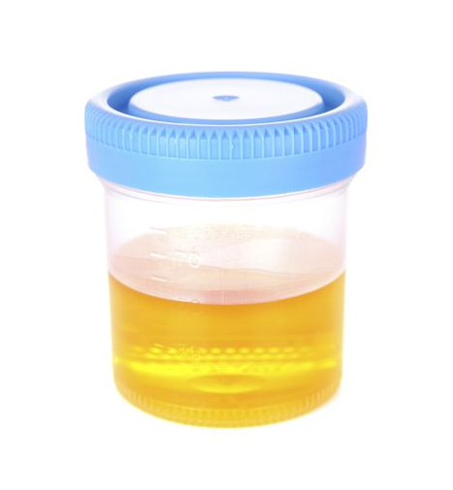
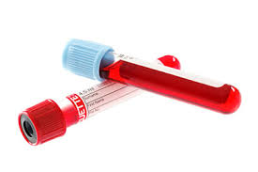
Proposed HBM-GV_{worker} - might be revised depending on the consultation outcomes
! Not protecting towards Cd carcinogenic effects !
10 - Summary
Urinary Cadmium (preferentially pre-shift sampling to avoid contaminations)
HBM-GV_{worker} 5 µg/g creat
Threshold for medical monitoring of the renal function 2 µg/g creat
Blood Cadmium (preferentially pre-shift sampling to avoid contaminations)
HBM-GV_{worker} 4 µg/L
For newly exposed workers on the field:
U-Cd
B-Cd (indicator of recent exposure to Cd as initial t_{1/2} is 2-3 months)
Tubulopathy effect markers (β2M or RBP) + complete renal function exam
For Cd-exposed workers (> 3 months):
B-Cd (after Cd accumulation in the kidney, B-Cd will be influenced by the total body burden)
U-Cd:
*if <2 µg/g crea  monitoring of β2M or RBP not necessary
*if >2 µg/g crea but <5µg/g crea  monitoring of β2M or RBP recommended
Notes:
The main Cd compounds found in the industry

Slide 17
Thanks to contributing colleagues : Farida Lamkarkach, Fatoumata Sissoko, Christophe Rousselle (ANSES) ANSES Working group on Biomarker of exposure Petra Apel & Rosa Lange (UBA)
Thanks for your attention
Contact: eva.ougier@anses.fr
Speaker’s information
Eva OUGIER PharmD works as a scientific officer, at the French Agency for Food, Environmental and Occupational Health & Safety, Maisons-Alfort, France. She received training in toxicology. In HBM4EU she is responsible/contributing for activities in WP4, WP5 and WP12.

Slide 18
HBM-GV_{Worker} for Cadmium
HBM-GV_{Worker} | Urinary Cadmium: 5 µg/g crea | High level of confidence (ongoing work)
Derivation method | Based on a relation between urinary Cd levels and biomarkers of renal early effects concentrations in humans Key studies: Chaumont et al. 2011 Measurement of U-Cd levels associated with levels of the biomarkers of renal effect β2M and RBP in a large population of French, European and American workers employed in 4 nickel-Cd battery plants (n = 599; mean age 45y), for 18.8 years on average. POD: BMD₅L₉₅ of 5.5 µg/g crea for abnormal levels of LMWPs (β2M and RBP) rounded to 5 µg/g crea | From the study of Jarup and Elinder, 1994 (workers aged > 60y): 2 µg/g crea as threshold value recommended for initiating monitoring of renal function urinary biomarkers such as β2M and RBP High for database: numerous human and workers studies High for key study: field human studies High for endpoint: BMDL construction (BMR 5%)

Slide 19
HBM-GV_{Worker} for Cadmium
HBM-GV_{Worker} | Blood Cadmium: 4 µg/L reflects the accumulated body burden over recent weeks / months | level of confidence (ongoing work)
Derivation method | Based on a relation between urinary Cd levels and biomarkers of renal early effects concentrations in humans + correlation between blood and urinary Cd concentrations Same key study and POD as for urinary Cadmium (Chaumont et al. 2011, POD at 5 µg/g crea) Key study for correlation between U-Cd and B-Cd: Zwennis & Franssen, 1992 Correlation between U-Cd and B-Cd studied in around 600 Cd-exposed workers from 16 different industries. Based on the equation of regression reported: U-Cd of 5 µg/g crea corresponds to B-Cd of 4 µg/L | High for database: numerous human and workers studies High for key study: field human studies High for endpoint: BMDL construction (BMR 5%)

Slide 20
3rd HBM4EU Training School - Brno - 20th of June 2019
Notes:
The main Cd compounds found in the industry

