Slide 1
Data needs for use of HBM in risk assessment
Jos BESSEMS
3rd HBM4EU Training School 2019
Course A13 – June 19, 2019

Slide 2
Tiers in Risk Assessment
HBM is a Screening Tool for
Interpretation of Biomonitoring Data
in a Risk Assessment Context

Slide 3
HBM-Based risk assessment steps
Overview
I - Epidemiological or toxicological information
II - Derivation guidance level safe internal exposure
III - Exposure information (HBM measurements)
IV - HBM-Based evaluation in a risk context
Contextualised exposure to assess applicability of HBM-GV

Slide 4
Requirements HBM
www German HBM Commission
SAMPLING + ANALYTICS
Sound chemical-analysis
Careful collection of the human samples
Thorough documentation of the test persons information
Pathways of human intake
Use of the substance
Occurrence and distribution substance in the environment
Human toxicokinetics, internal exposure, relevant biomarker
Health relevance
CONTEXTUALISATION
ADME + TK

Slide 5
Biospecimen + Biomarker
Matrix
Blood
Urine
Hair/Nails
Biomarker of exposure
Parent
Metabolite
Parent + Metabolite (e.g. BPA and BPA-glucuronide)
Angerer et al., 2011

Slide 6
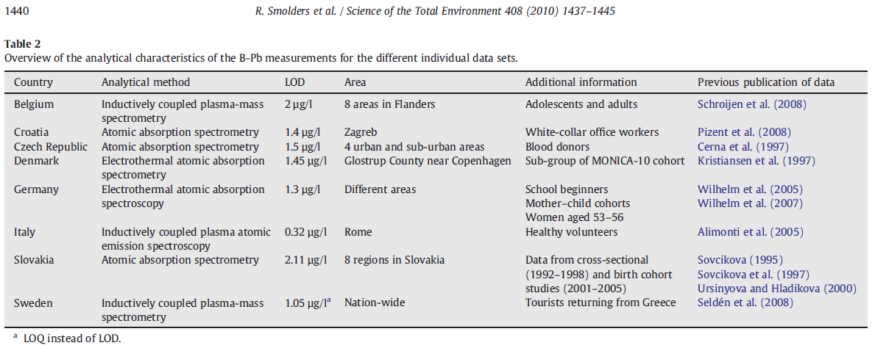
Variation in analytical chemistry

Slide 7
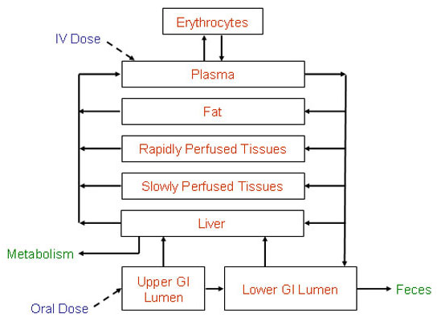
Time-activity
pattern
Life-style
Exposure profile
Age, gender,
ethnicity,…
Internal concentration-time (C,t)-profile
Toxicokinetic variability
Specific toxicokinetic model,
i.e. PBTK model

Slide 8
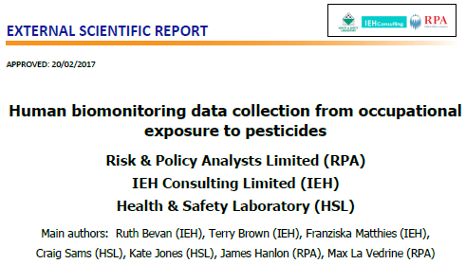
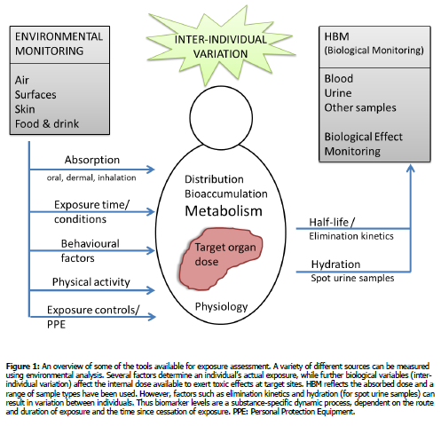

Slide 9
It’s all about
Relevance
Uncertainty
NEEDS
Exposure BM
specificity
Time-activity
patterns
SES
Concentration
Timing of sampling
Exposure factors
Confounders
Lifestyle
Sex
Duration
Susceptibility
Vulnerability
Exposure routes
Age
Sampling matrix
ADME → TK

Slide 10
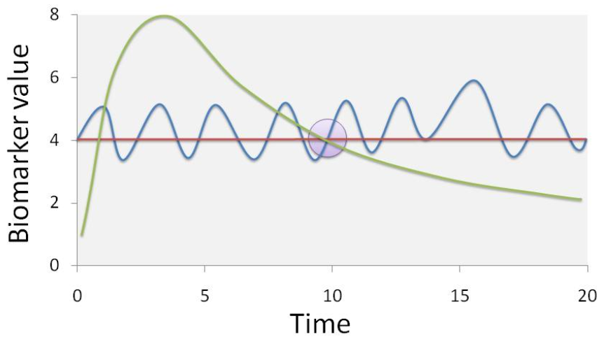
Needed: Exposure variables → Contextualisation
Exposure variables
Black Box
Time-activity
patterns
ADME
Concentration
Confounders
Timing
Lifestyle
Duration
Susceptibility
Internal Exposure
?
Need to know ‘applicability domain’ of HBM-GV
HBM-GV
HBM Point measurement

Slide 11
Human biomonitoring guidance values
HBM Assessment values (Angerer et al, 2011)
HBM I (German HBM Commission)
HBM II (German HBM Commission)
BE - Biomonitoring equivalent (Summit Toxicology)
Modelled internal exposure equivalent of an external exposure value (an animal POD like BMDL or NOAEL, an animal POD derived human limit value like ADI, TDI, RfD, or a human POD derived from epidemiological studies)
HBM-GV (HBM4EU)

Slide 12
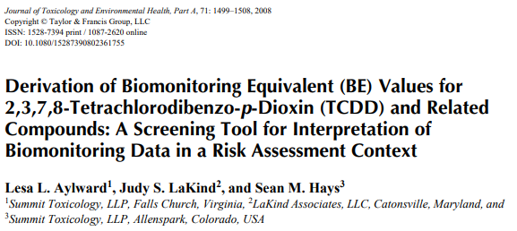
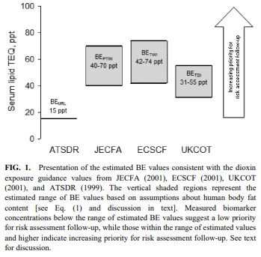

Slide 13
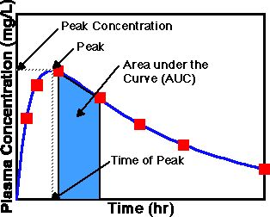
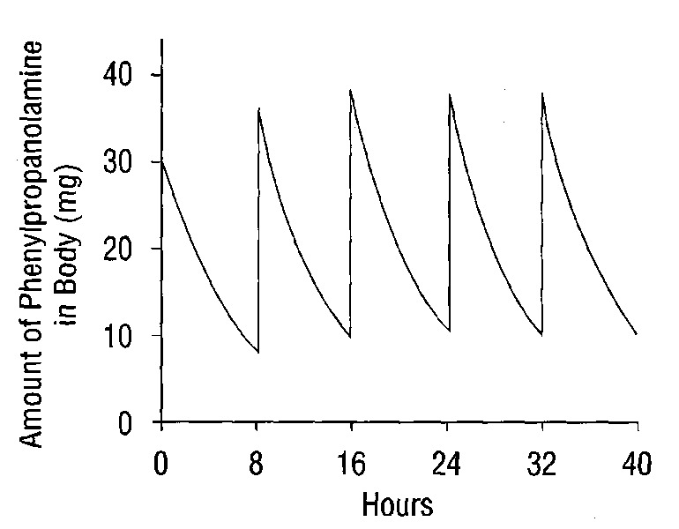
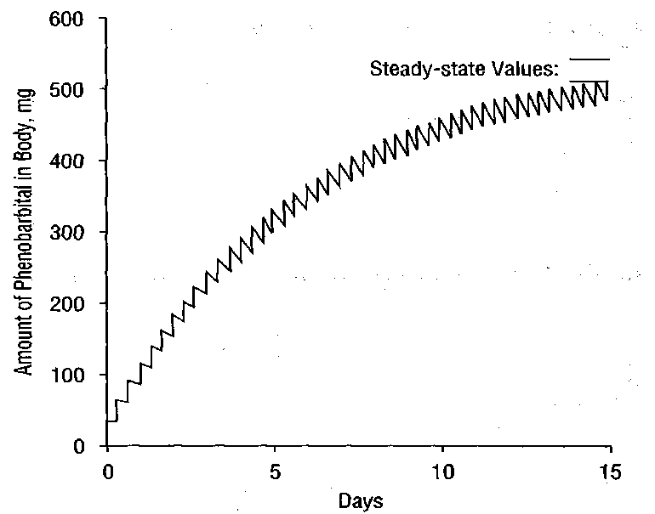
Variation in exposure, TK and C,t-curve
Single exposure Repeated exposure

Slide 14
Specific needs toxicokinetics (TK)
ADME + TK
Careful selection of relevant exposure biomarker
Carefully correlating external and internal exposure
Slow toxicokinetics → long half-life
Only steady state levels (dose per day in = dose per day out)
Rapid toxicokinetics → short half-life
Fluctuating C,t –curve → Careful contemplation external exposure
Biomarker parent or metabolite or parent + metabolite (e.g. BPA + GLUC) ?
Toxicokinetic modelling is key need

Slide 15
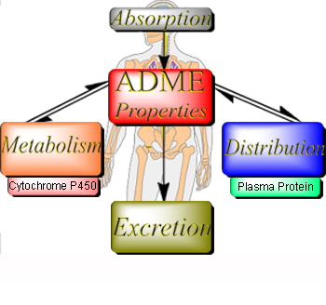
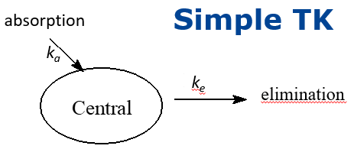
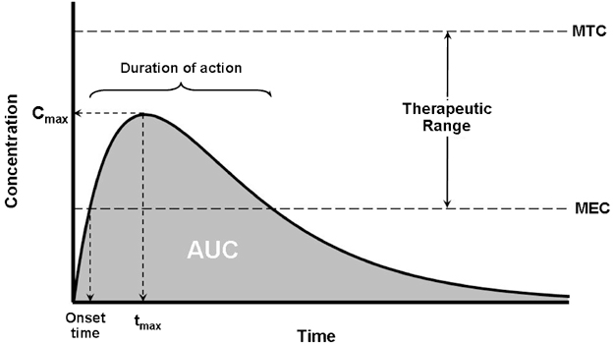
TK Model simulation
C,t-curve
PBTK
Blood C,t-curve (concentration –time curve)
Toxic Concentration
Biomarker: Parent chemical ? Metabolite ?
Biomarker concentration to pollutant intake
What is relevant for HBM ?

Slide 16
Increasing complexity of (TK modelling) approaches used
www German HBM Commission

Slide 17
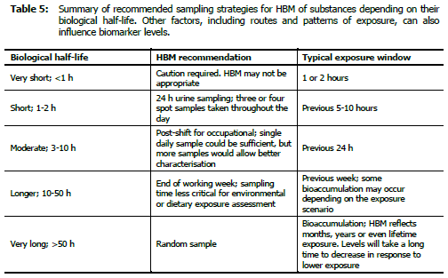
Sampling strategy based on half-life
Bevan et al., 2017

Slide 18
www German HBM Commission

Slide 19
Relevance and Uncertainty
Exposure variables
Black Box
Time-activity
patterns
ADME
Concentration
Confounders
Timing
Lifestyle
Duration
Susceptibility
Internal Exposure
?
Need to know ‘applicability domain’ of HBM-GV
HBM-GV
HBM Point measurement

Slide 20
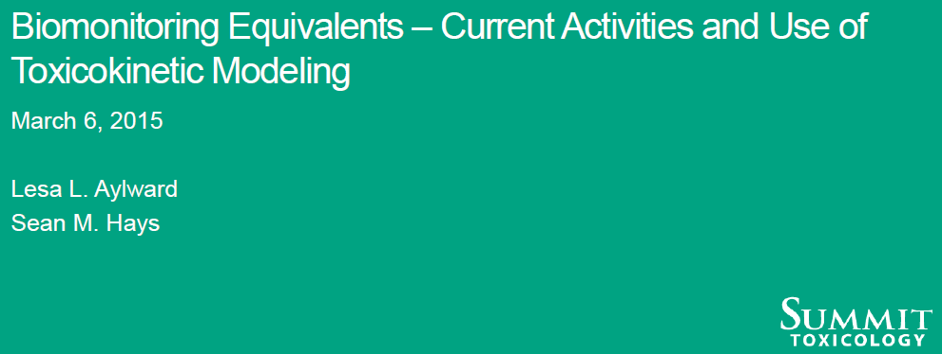
www German HBM Commission

Slide 21
www German HBM Commission

Slide 22
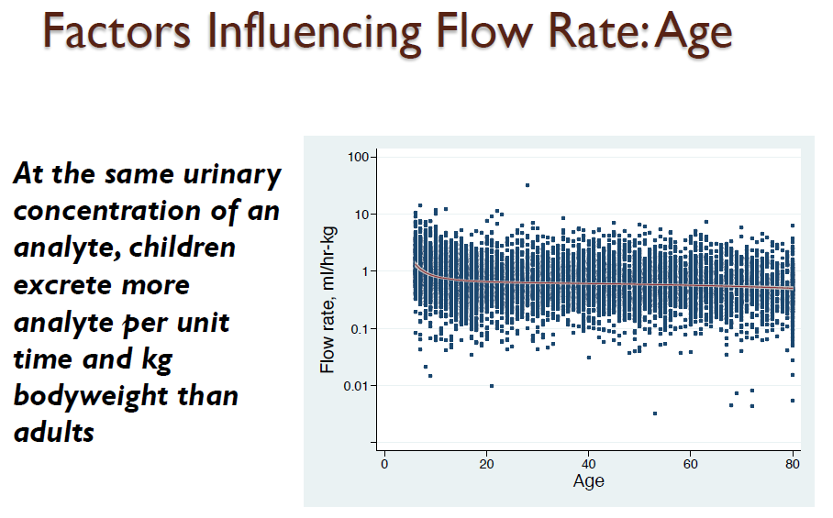
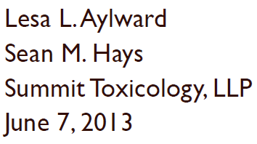
www German HBM Commission

Slide 23
Purpose of the risk assessment
Average human exposure versus HBM-GV
Sex-specific risk assessment
Age-specific risk assessment (children and adolescents have higher food intake in g/kg bw/d)
First tier screening risk assessment
Higher tier focussed risk assessment

Slide 24
Age-dependency
UBA - HBM Commision

Slide 25
Tiers in HBM-based RA and BM needs
More specific RA → more specific subpopulation BM data
P95 General population BM levels vs HBM-GV
1
P95 Sex-specific BM levels
P95 ‘Age category’-specific BM levels
P95 Worker-specific BM levels
2
More stratification (SES, smoking, pregnancy, diet)
Distance to point emission (e.g. PFOA industry)
3
Increasing limitations:
Confounding factors in looking for causal relationships
Limited size subpopulations (# participants)

Slide 26
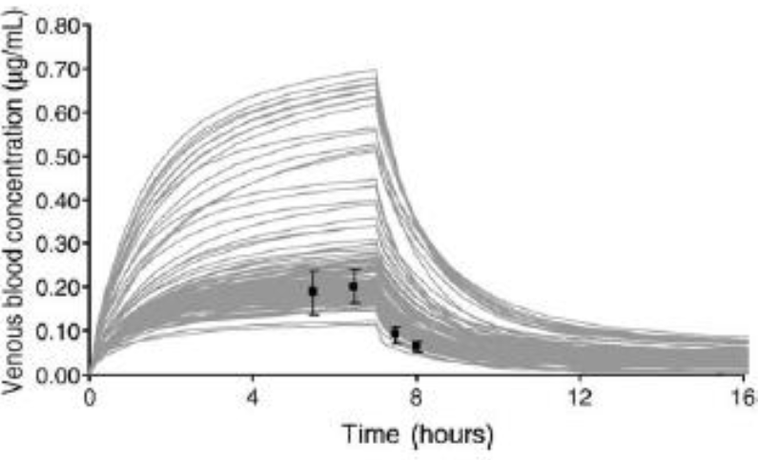
Predicted and measured toluene in blood
www German HBM Commission
Interindividual variation > 5-fold

Slide 27
Crucial differences worker vs general population
Risk assessment general population
All exposure routes (oral, dermal and via inhalation)
Duration
24 h (air pollutants; indoor or outdoor)
Several times per day (food, drinking water)
Many hours (toys, contaminated dust)
Risk assessment worker
Different exposure times and duration (8h max)
Different exposure routes (dermal and via inhalation)
Different exposure levels (often significantly higher)
More narrow subpopulation (healthy worker)

Slide 28
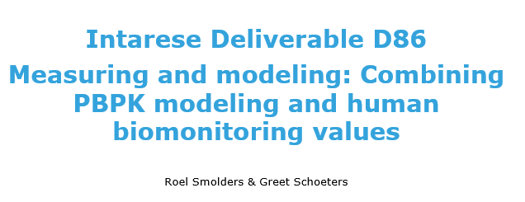
Three C,t-curve examples and one single HBM-sample

Slide 29
Relevance and Uncertainty Knowledge Needs
Exposure variables
Black Box
Time-activity
patterns
ADME
Concentration
Confounders
Timing
Lifestyle
Duration
Susceptibility
Internal Exposure
?
Need to know ‘applicability domain’ of HBM-GV
HBM-GV
HBM Point measurement

Slide 30
Contact jos.bessems@vito.be
Speaker’s information
European Dutchman Jos BESSEMS works as senior scientist at VITO Health in Mol, Belgium.
Chemical risk assessor for >20 years. Working now to increase the use of human biomonitoring data in mainstream chemicals management and active in the science-policy nexus.

